Slide 1


Content-based Course Recommender System for Liberal Arts Education
Raphaël Morsomme Sofia Vazquez Alferez

Slide 2
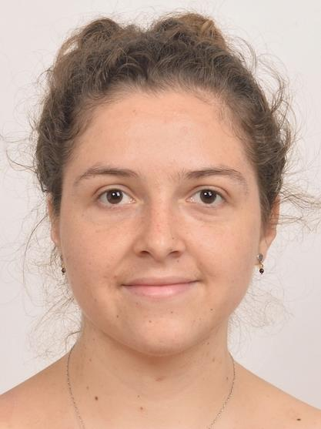
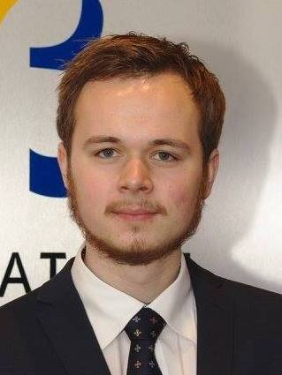

Sofia Vazquez Alferez
sofia.vazquezalferez@maastrichtuniversity.nl
Raphaël Morsomme
raphael.morsomme@maastrichtuniversity.nl

Slide 3

Content
The Task
University College Maastricht
Recommendation Task
Constrain
Objectives
Our Data
Proposed Approach:
Proposed approach
Proposed Recommender
Workflow
Topic Modeling
Lasso Regularized Sparse Linear Model
Demonstration

Slide 4
1. The Task

Slide 5
University College Maastricht
Liberal Arts and Science Program
Interdisciplinary
150 courses
Over 75% free educational credits
Up to one year of external courses

Slide 6
“The college gives you the freedom to construct your own curriculum while your academic advisor helps you navigate through the options”
Student Handbook 2018-2019
Notes:
Most important word is the last one

Slide 7
University College Maastricht
Overview problem:
150 courses at UCM + 2327 courses offered at other 12 Faculties
Unique curriculum problem:
Is a student prepared for a course?

Slide 8
Recommendation Task
What interesting courses are offered at the university?
Do I have sufficient pre-knowledge for this course?
What courses can I take to prepare for this course?

Slide 9
Constraint
“Primarily academic advisors provide their advisees with feedback and incentives to actively take responsibility for how they organize their studies”
Office of Academic Advising UCM

Slide 10
Objectives
Course Suggestion
Warning Issuance
Preparatory Course Advice
Some explanatory information

Slide 11
Our Data
Student Academic Transcripts

Slide 12
Our Data
Course Catalogues

Slide 13
2. Proposed Approach

Slide 14

Proposed Approach
Course Data
Discover Topics
Latent Dirichlet Allocation (LDA)
Lower dimensionality
Student Specific Data
Predict performance
Lasso & CV
Past academic performance
Topic Expertise

Slide 15
Proposed Recommender
Discover topics in the course data
Ask user to describe their interest (using key words)
Match interest of students to topics.
Retrieve relevant courses based on topics
Assess risk of failure for prospective courses
If at risk, recommend preparatory courses

Slide 17
Topic Model Terminology
Topic:
Probability distribution over finite set of words (Vocabulary)
Document:
("Probability distribution over topics”)
Sequence of N words
each word was generated by drawing from a probability distribution over topics specific to that document.

Slide 18
LDA Document generation
Given a number of topics k:
Determine word distribution per topic:
β ~ Dirichlet(δ)
Determine weight of topics per document:
𝜃 ~ Dirichlet(α)
For each of the N words in a document:
Choose a topic z ~ Multinomial(𝜃 )
Choose the word w ~ Multinomial(β_{z})

Slide 19
Learning LDA distributions
Use Gibbs sampling to infer:
β - word distribution per topic
Prior: Dirichlet(δ)
𝜃 - distribution of topics per document:
Prior: Dirichlet(α)
δ and α influence the sparseness of distributions

Slide 20
β – distributions for two topics
𝜃 – distributions for two topics

Slide 21
Determining K
δ = 0.1
α = 50/k
Find maximum Log-likelihood
K = 5, 10, …, 150
Model with 65 topics has the maximum log likelihood.

Slide 22
Student Performance Prediction Terminology
Past Academic Performance:
GPA for:
Humanities
Natural Sciences
Social Sciences
Skills
Projects
Topic Expertise:
Knowledge acquired by student in each of the 65 topics from previous step:
Sum of the topic distribution of courses taken by the student weighted by attained grades

Slide 23
Student Topic Expertise
Topic distributions per course
Student transcript
Course contribution to Topic Expertise
Topic Expertise

Slide 24
Predicting Student Performance
For each of the 132 courses currently offered (enrolments > 20 since 2008):
Fit a sparse multiple linear regression model for grade prediction
Predictors:
Past Academic Performance
Student’s Topic Expertise
Regularization:
lasso penalty: shrinks the coefficient estimates of the model, thereby reducing its variance.

Slide 25
Determining λ
Use 10-fold cross-validation (CV)
Find the lasso tuning parameter λ that minimizes the CV mean absolute error
Cross-validation mean absolute error in the 148 predictive models

Slide 26
Preparatory Courses
Fit lasso-regularized multiple linear regression model for grade prediction to each course
Predictors:
Students’ topic expertise.
Preparatory courses :
5 courses (excluding advanced courses)
Whose topic distribution has the smallest KL distance to the course’s regression’s normalized coefficient estimates.

Slide 27
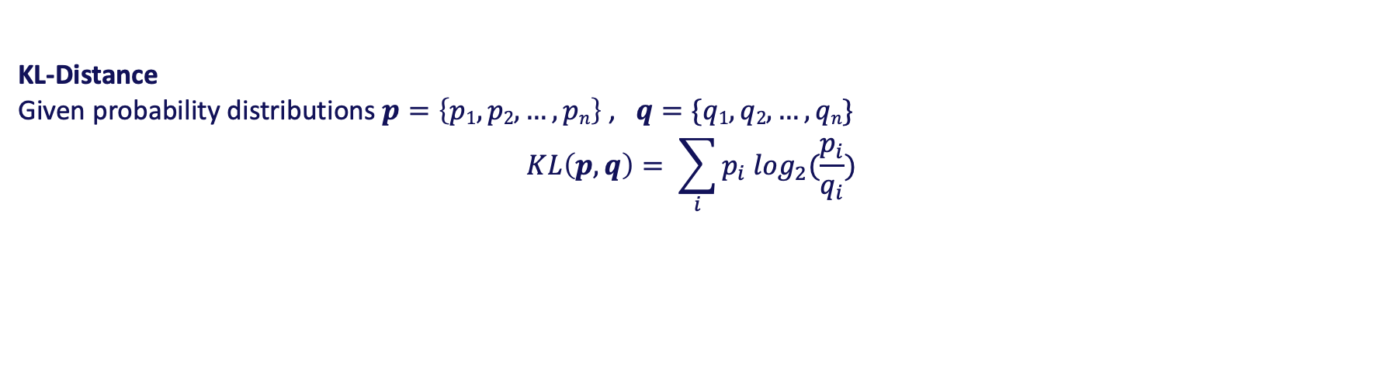
Recommendations
Given a set of key words passed by the user
Build student interest distribution: a ‘probability distribution’ over topics.
Use KL-Distance to find closest courses to that distribution.
Given a set of prospective courses
Predict grade of student
Find preparatory courses using KL- distance to coefficients
KL-Distance
Given probability distributions $p=\left\{p1, p2,…, pn\right\}$ , $q=\{q1, q2,…, qn\}$
$$KL\left(p,q\right)= \sum_{i}{p_{i} \log_{2}(\frac{p_{i}}{q_{i}})}$$

Slide 29
3. Demonstration

Slide 30
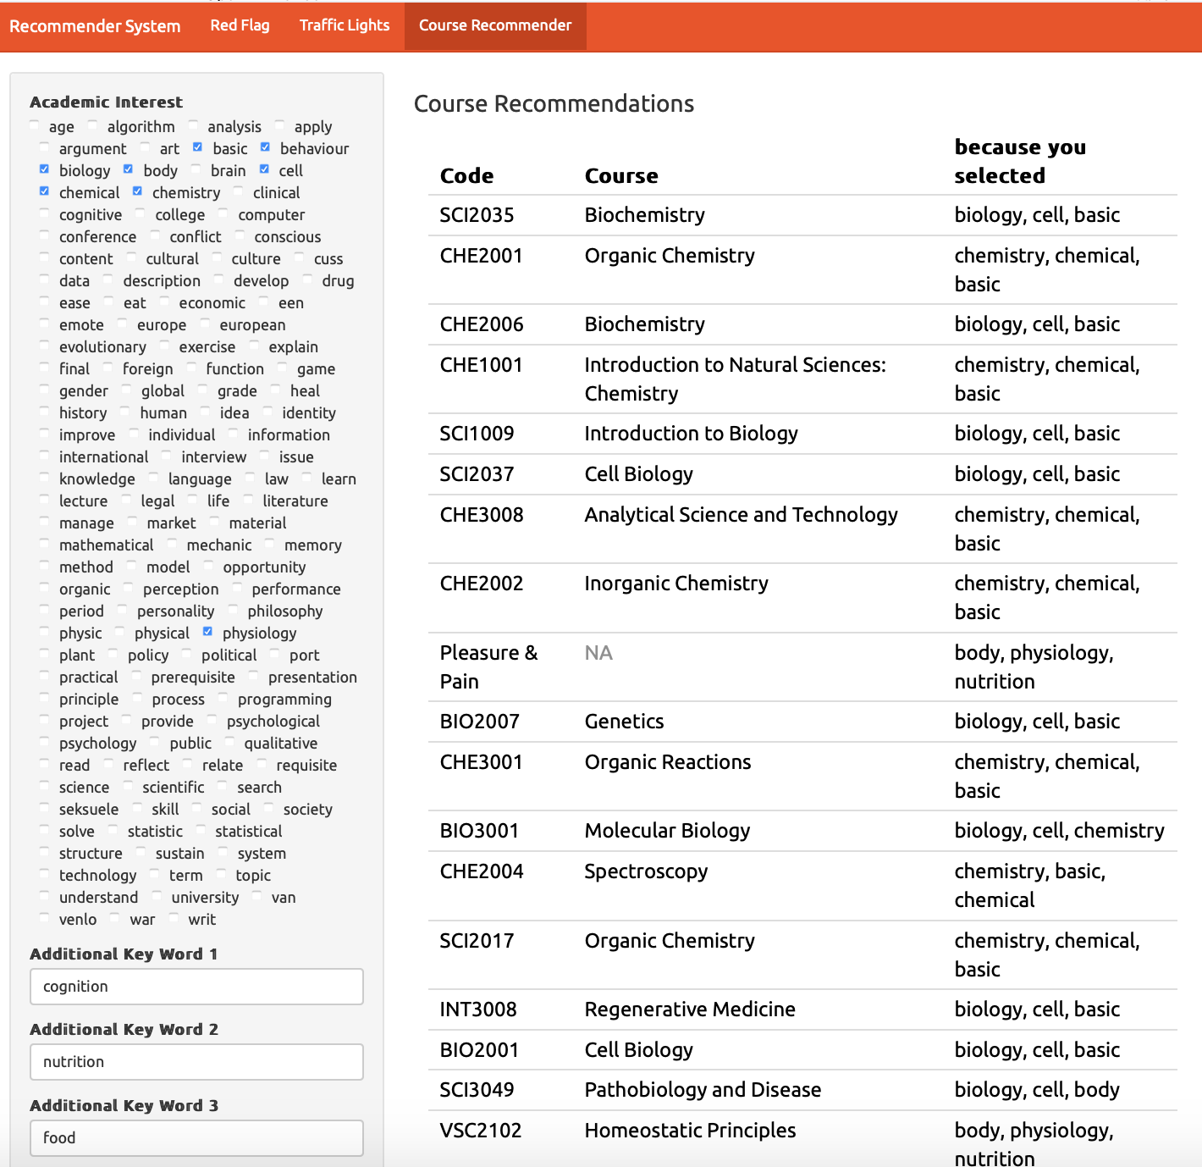

Slide 31
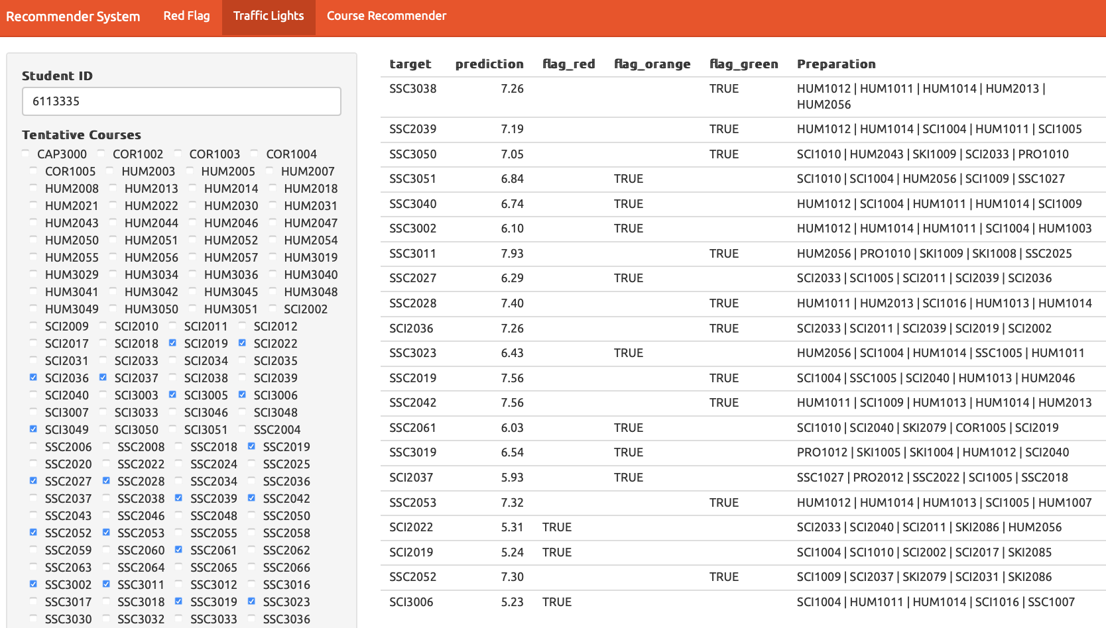

Slide 32
Thank you!
Sofia Vazquez Alferez
sofia.vazquezalferez@maastrichtuniversity.nl
Raphaël Morsomme
raphael.morsomme@maastrichtuniversity.nl

